Slide 1
Team Statistics - IPL Data Analysis Assignment
https://public.tableau.com/views/IPLDataAnalysisAssignment/Dashboard-IIITeamStatistics?:language=en-US&publish=yes&:display_count=n&:origin=viz_share_link

Slide 2
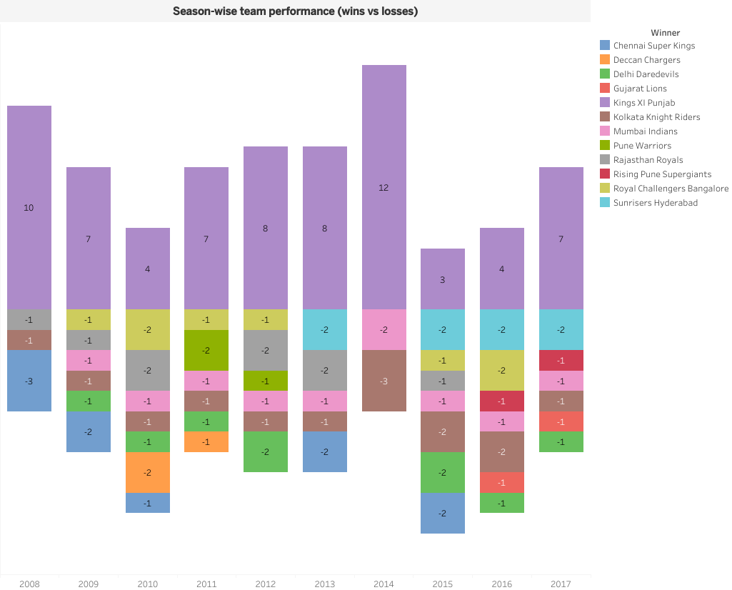

Slide 3
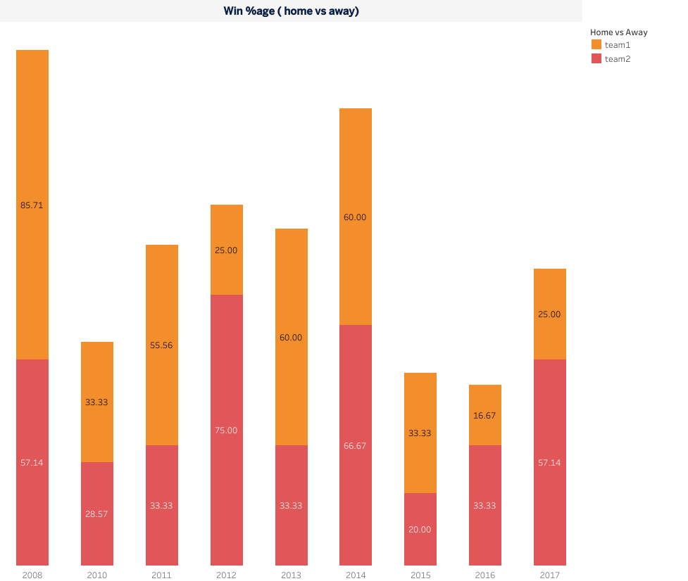

Slide 4
